Slide 1
Smart University
System
A software project developed by
M.G.Husny Ahamed

Slide 2



Why this project ?
To overcome some commonly faced
problems in ICBT
by
Management/Staff
Students
Lecturers

Slide 3






AND ALSO To be in the game among competitors
SO THERE SHOULD BE SOMETHING SPECIAL IN ICBT, TO CHOOSE ICBT
Who are competitors

Slide 4

Objectives of the project
Improve the security of the university.
Prevent business losses in the organization and increase profit.
Satisfy the lecturers, students and staff of ICBT
Attract new students and lecturers to the university
Save time and cost to meet the maximum
efficiency
TO REACH HIGHS AND GOALS

Slide 5
NOW WE WILL PEEP INTO PROBLEMS FACED IN ICBT

Slide 6


icbt management – Problem No.1
Students do not pay fees on time
I don’t need any certificate. I want only the knowledge
I don’t pay fees
No way to prevent students coming to lectures, who have payment arrears

Slide 7


May lead to Crisis in the Business of ICBT
How can we track them? There are large number of students
Students payment arrears are loaded. Why is this?
ICBT management

Slide 8
icbt management – Problem No.2
Attendance are marked manually
Someone has to be hired. To enter them to the database,
It takes more time and cost
Entering attendance details in database

Slide 9

icbt management – Problem 3
Outsiders can enter lecture rooms or computer labs
It is a threat to the security
I'm not a student/
not a ICBT student
(No one noticed )
Computer lab

Slide 10

Problems faced by Students
Problem no.4
Lecture schedule or lecture room changed on the same day
Student / Lecturer
Where is the lecture room today?
Bad management
I'm fed-up
What time is the lecture today?

Slide 11
Problems faced by lecturers
Problem no.5
Students are not in the lecture room when the lecturer comes
They may outside chatting with friends
Lecturer comes in to the class room
Where are these students????
I'm fed up with these students

Slide 12

Problems faced by Students
Problem no.6
No way to know if the lecturer came into the class room
Is the lecturer came to the class?
Student chatting outside assuming that lecturer did not come yet
Student

Slide 13
All those problems
Should be solved

Slide 14

How Am I going to solve all those problems?
I was creative with many ideas in my mind
FIRST WE NEED AN ACCESS CONTROL MECHANISM TO ICBT
Staff member staying at the entrance for checking students card
Manpower cost , Accuracy issue ..
Finger print access control ?? IMAGE PROCESSING SUXX COST IS HIGH
Face recognition access control ???
Again image processing cost is high
Eye retina scanning access control??????
Nooooo wayyyyy…. Ethical problems ☹ ☹ ☹

Slide 15

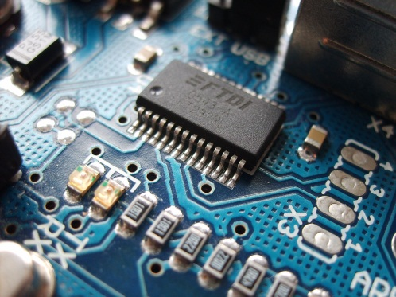



I have some knowledge of Micro controller and electronics I can use them to solve them
Yeah :D I found the solution
Micro controller
Radio frequency waves
RFID tag

Slide 16
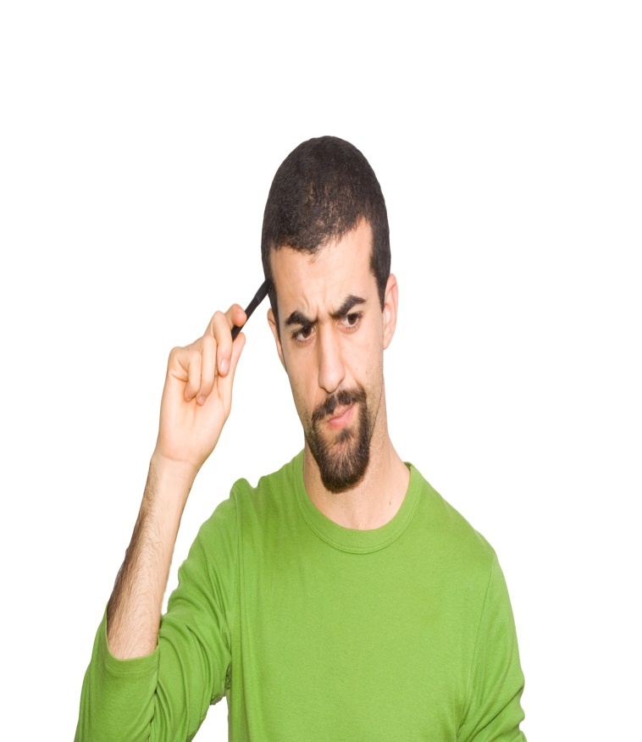
BUT WITH MICRO CONTROLLER, I HAVE TO WRITE THOUSANDS OF CODES ☹ ☹ ☹
NO TIME TOO☹

Slide 17

BUT HOW ABOUT ARDUINO?
Micro controller is just like C
Arduino is just like Java , with less amount of code compared to C
But I do not know Arduino programming
I have to take a risky challenge to go with Arduino. ☹

Slide 18
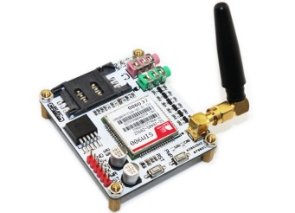
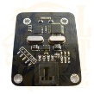
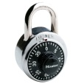

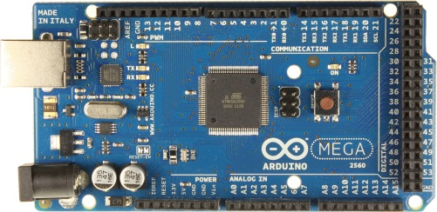
Architectural diagram
LAB 1
RFID 13.56MHz Reader Modules
LCD
University
Management system
software
SIMS900
GSM/GPRS Module
LAB 2
+
LCD
Arduino Mega 250
LAB 3
All the doors have door locks And rfid readers, Students have to swipe their rfid tag to access
LCD

Slide 19
Now will see how the problems are solved

Slide 20
Problem no.1
Students who haven’t paid arrears can still attend lectures
What is the solution?

Slide 21

When a student tries to enter class room, he/she has to swipe the rfid tag to the reader
Student with a particular amount of payment arrears will be blocked the entrance
Example condition fee = 540,000/-
If fee/2 > paidAmount
Student paid only 135,000/-
Class room
I didn’t pay arrears. I cant enter the lecture room
Access
Denied

Slide 22
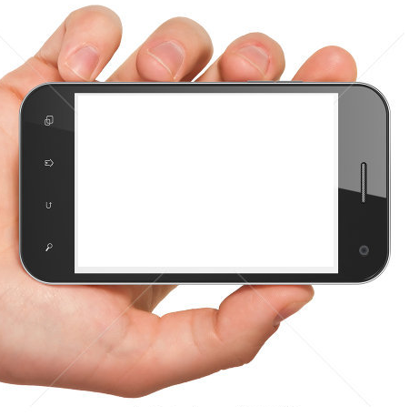
Text message received
From : ICBT
You cannot access any lecture room You have payment arrears to be settled. [Pay Rs.135,000/- to access lectures]
Contact accounts department

Slide 23
Problem No.2
Attendance are marked manually and it takes more time and cost
How is it solved??
Attendance are recorded when rfid card is swiped

Slide 24

icbt management – Problem 3
Outsiders can enter lecture rooms or computer labs, It is a threat to the security
How is it solved?
Only registered members with rfid tags can access, the door is locked
Door locked

Slide 25
Problem no.4 faced by Students
Lecture schedule or room changed suddenly
How is it solved?
A text message will be sent to the students or lecturer when a lecture room or schedule is changed
Alert - ICBT
Lecture room changed from room 2 to room 5
Sorry for the inconvenience caused

Slide 26
Problem 5 and 6
No way to know when the lecturer comes to the class
How is it solved?
A text message will be sent to the students when the lecturer comes into the class
Alert - ICBT
Lecture came into the class Please attend the lecture

Slide 27
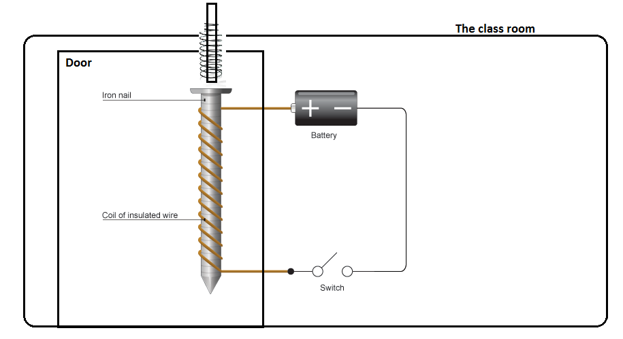
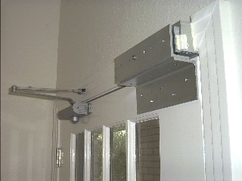
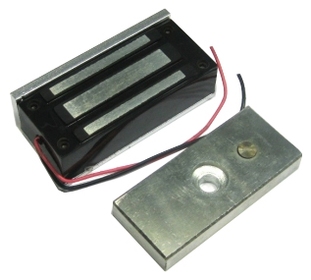
Technical explanation of the system
How real electromagnetic door lock works
Technique 1 – used in homes
Technique 2 – used in industries

Slide 28

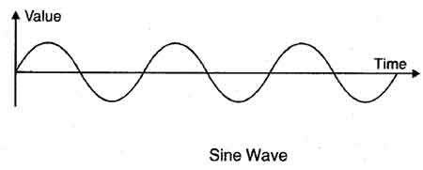
How arduino works
Oscillator to time count
Digital signal pins
Analog Signal pins
Examples
Pulse with modulation - PVM
RFID reader
Examples
Camera module
Proximity sensor
Light sensor

Slide 29
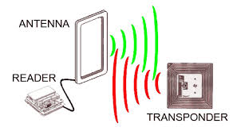
RFID reading
Active tags – with inbuilt battery
Passive tags – no battery

Slide 30
Estimated lost by unpaid students
Installment | Time for payment | Amount (X) | Expected income for 5 students (Y) X*5 = Y | Gained income (with the unpaid students)
1st installment | January | 68,000/- | 340,000/- | 272,000/- (1 students unpaid)
2nd installment | March | 68,000/- | 340,000/- | 204,000/- (2 students unpaid)
3rd installment | May | 68,000/- | 340,000/- | 272,000/- (1 students unpaid)
4th installment | July | 68,000/- | 340,000/- | 340,000/- (all paid)
5th installment | September | 68,000/- | 340,000/- | 68,000/- (4 students unpaid)
Expected income |  |  | 1,700,000/-
Total income gained after the lost |  |  |  | 1,156,000/-
Total lost by unpaid students 1,700,000 - 1,156,000 = 544,000/-

Slide 31

So implementing the developed system will regulate the income of icbt and solve all those problems

Slide 32
Thank you

